Slide 1


PERSONALIZED PAIN MANAGEMENT SYSTEM

Slide 2



UNDERSTANDING THE PROBLEM
Misuse of opioids
1
Patients
Misuse of opioids
Addiction and Deaths
Lack of knowledge and real time data
2
Doctors
Undertreated patient
Huge financial losses
3
Big Pharma
Wave of opioids lawsuits
Personalized Pain Management System - www.docomed.com
®

Slide 3



THE OPIOIDS CRISIS IN THE US
The current opioid epidemic is the deadliest drug crisis in American history. Overdoses, fueled by opioids, are the leading cause of death for Americans under 50 years old — killing roughly 64,000 people last year, more than guns or car accidents, and doing so at a pace faster than the H.I.V. epidemic did at its peak. (New York Times, Oct. 26, 2017)
Last year 214,881,622 Opioid prescription were given to patient in the US. 61,862,364 patient received at least one Opioid prescription.
In October 2017, the Opioid Crisis in the U.S was declared a “national health emergency”
Personalised Pain Management System - www.docomed.com
®

Slide 4

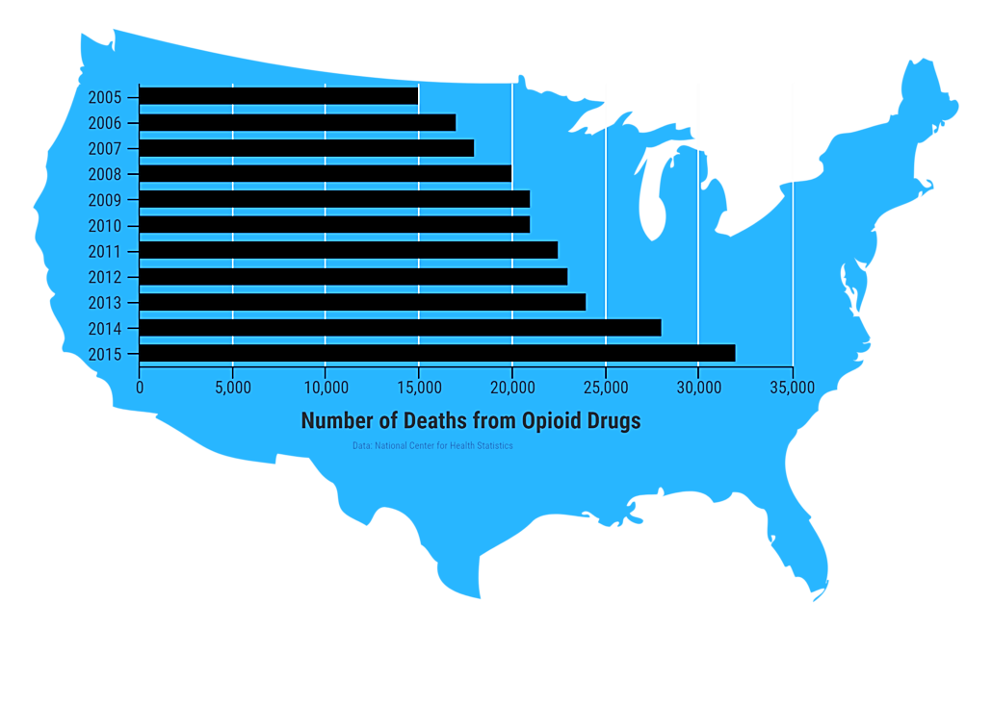
THE OPIOIDS CRISIS IN THE US
214 million
Opioids prescription
2.1 million
People misused prescription opioids for the first time
Deaths attributed to overdosing on commonly prescribed opioids
15,281
78 billion $
Annual available market – $ 2.6 Billion
In economic cost
Personalised Pain Management System - www.docomed.com
®

Slide 5


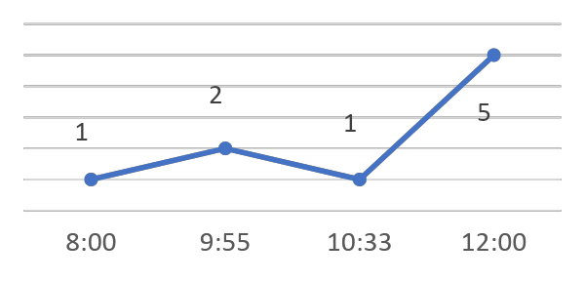





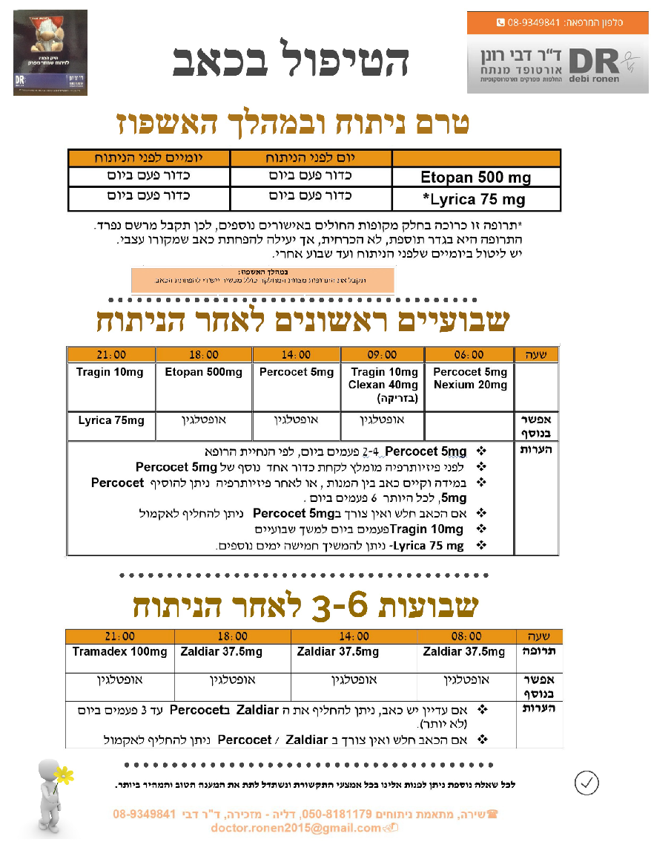
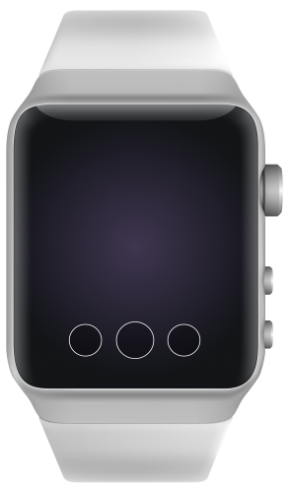



OUR SOLUTION
An application for the patient
An application for the doctor
A dedicated App for elderly patients
Hello Jack, how do you feel?
Personalized pain management system
A Cloud service data base
Terrible!!
Really bad!
Not good
Can be better
OK
Percocet 5 ml Take now!
Any side-effects?
Personalised Pain Management System - www.docomed.com
®

Slide 6



Our System advantages
Considers the patient current pain level and previous consumption
Identify and alerts potential addiction symptoms in real-time
Application for the Doctor:
Notifies the patient which medication to take and when
Provides a personalized future prescription for the patient
Application / Device for the Patient:
Studying the patient according to the physiologic factors in a direct
connection to the subjective data
Decreases total dosage given on real time while continuing with prescribed medication
Recommended benchmark/ suggested prescriptions for patients based on a professional pain treatment protocol together with the treating doctor's input
Provide data on the patient’s level of pain, medication consumption, side effects and overall effectiveness of the treatment regime over the time of healing
Web Tracking and Data analysis tool:
Personalised Pain Management System - www.docomed.com
®

Slide 7

FOR ACUTE AND CHRONIC PATIENTS
Doctors
Acute Pain Patient
Chronic pain patient
Helps physicians with a lack of pain management experience, especially with opiates for acute and chronic pain
Receives short and focused treatment in the proper and optimal combination of drugs and activities to prevent future medical complication in the
Receive long-term treatment that includes other options to treat pain. Gives the patient options to better under-stand how to manage the chronic pain
Personalised Pain Management System - www.docomed.com
®

Slide 8




Competitors
Managing medication consumption
Pharmaceutical company: Coping with chronic pain
Protocol management
Pain monitoring
Personalised Pain Management System - www.docomed.com
®

Slide 9
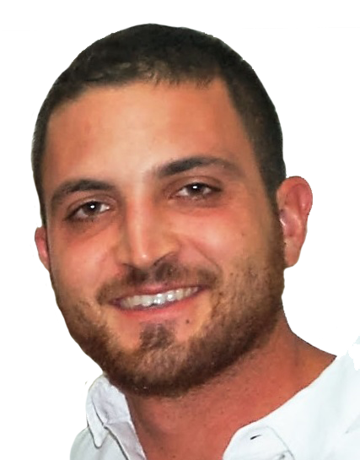



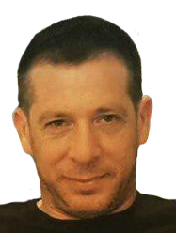
THE TEAM
Omri Schanin
Co-Founder & CEO
Amir Hasidim
Co-Founder & Chairman
Dr Omri Lubovsky
Co-Founder & Chief
Medical Officer
Prof Elon Eisenberg
Head of advisory board
Micha Oestereich
Regulatory affairs
Entrepreneur in the fields
of Life Science and Clean
Tech. Naval academy
graduate and combat
officer (Res.). Former 2nd
in command of an Israel
IDF navy ship, special
operations officer and
team leader at flotilla 3.
Seasoned entrepreneur and investor, Over 20 years of senior executive experience with med-tech startups. Managing partner at Biosphere capital. Former head of Gefen Biomed Ventures, CEO of A.T.I. & Meytav tech’ incubators.
Deputy director of the
department of orthopedic
surgery, Barzilai Medical
Center. Former physician at
the prestigious IDF airborne
Rescue & evacuation unit.
Inventor and founder with
experience as
professional high skilled
critical care physician.
Director of the Pain
Research Unit at the Institute of Pain Medicine, Rambam Health Care Campus, Haifa, Israel, and he is an associate professor of neurology and pain medicine at the faculty of medicine in the Technion Israel Institute of Technology.
Has been specializing in the field of regulation for over the past 15 years and in several medical companies.
Served as chief consultant in several companies, among them Ornim Medical and medasense
Personalised Pain Management System - www.docomed.com
®

Slide 10
TIMELINE
First Application and Data base collection
End of regulation
And evaluation
process
A first milestone, an algorithm that gives a pharmacological recommendation following a subjective pain level and side effects. Next, a second funding round will be held in order to link physiological and subjective measures to give a more accurate recommendation in real time
Q2
Q5
Q4
Q6
Full stack Algorithm & application, clinical trial
Pilot Sales and Marketing
Personalised Pain Management System - www.docomed.com
®

Slide 11
FUNDING
1
18 Months
1 M $
Full stack Algorithm & application
6 months I $250K
2
Clinical Trial
6 months I $300K
3
Regulation and evaluation
3 months I $350K
4
Pilot sales and Marketing
3 months I $360K
Personalised Pain Management System - www.docomed.com
®
This Text is Editable

Slide 12


Omri Schanin
CEO & CO-Founder
+972-54-303-3550
omri@docomed.com
Personalised Pain Management System - www.docomed.com

